Slide 1

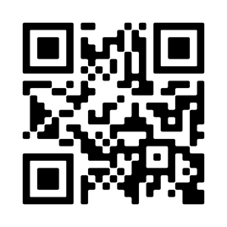
Love is in the Air
How to Make Employees Feel Like They Matter.

Slide 2


Abraham
Gonzales-Pollick
Abraham came to Vensure with deeply rooted passion for client service, organizational strategy, and building relationships! He started his HR career journey after 14 years of being an entrepreneur and running a successful General Contracting business. He has more than 25 years of client service and product management leadership experience, 15 of which have been spent in the PEO space. He is a highly-regarded keynote speaker and global facilitator on several development topics! Abraham has served on boards for non-profit organizations for over 10 years and led as Board Chair, before giving light to new passions!! Today he mentors young entrepreneurs on building the future! He holds is B.A. in Organizational Management with a minor in Social-Culture Anthropology, and MPA studies in Product Development.
Notes:
Thank you for this warm introduction!
Hello everyone!
Thank you for joining us today and giving us your time to learn with us.
I was super excited to be invited to present this topic on New Year New You!

Slide 3
Today’s Topic
Topic: Love Is In The Air:
How to make employee’s feel like they matter! For real.
Description:
From the first meeting at an interview to a meaningful development plan, and sometimes a goodbye. What is really important to the employee, the business…everyone?
Notes:
Todays content is about building awareness around various key phases in the employee experience. We examine what is happening workwise and personally so that leaders and peer can help create strong experiences and help people feel like they matter! Understanding is the first step. Let’s jump in!

Slide 4

Today’s Agenda
01. Employee Life Cycle
02. Examining the person
03. Career and Personal Demands
04. Ways to Engage
05. You Matter!
© 2023 Vensure Employer Services

Slide 5
Recruiting
Offer
Hiring
onboarding
Development
Performance Review
Next
Exit
Everything in
between
The Employee Lifecycle

Slide 6


Recruiting
  Its not just about posting the position.
  How do people know how to find your organization?
  Every organization defines job titles a little differently.
  Building relationships-finding talent.
  Interview experience can be a deal breaker.

Slide 7
Offer
Competitive
Incentives
Company Culture
Delivery Matters: How and by Whom
Hiring
Communication
Introductions
What to Expect
Notes:
When you get to the offer and hiring phase this is where there is an opportunity demonstrate to your future employee that you value their time and what THEY bring to the table. Its also a nice gesture that says thank you for choosing us.

Slide 8

Onboarding
  Day 1
    Week 1
    Week 2
    Week 3
  30 Days
  60 Days
  90 Days

Slide 9
Development Plans
What do you bring to the table?
What are the strengths?
What do we need to work on?
What is next?
Performance Reviews
What is Expected
No Surprises
Roadmap to Success
Feedback Both Ways
Notes:
When you get to the offer and hiring phase this is where there is an opportunity demonstrate to your future employee that you value their time and what THEY bring to the table. Its also a nice gesture that says thank you for choosing us.

Slide 10

What is Next
  Sometimes a promotion is not always what should be next
  Upskilling
  Cross training
  Lateral move
  Certifications

Slide 11
Exit
External factors
Internal factors
Goals
When its time, its time.
Everything in Between
Employee experience
Business need
Notes:
When you get to the offer and hiring phase this is where there is an opportunity demonstrate to your future employee that you value their time and what THEY bring to the table. Its also a nice gesture that says thank you for choosing us.

Slide 12
Things to Consider
Employee Lifecycle
Best Practices:
There is opportunity to demonstrate how much we value our employees in every stage of the lifecycle.
Determine what you want the employee experience to be in every stage.
Does it align with you company culture?

Slide 13

Examining the Person

Slide 14
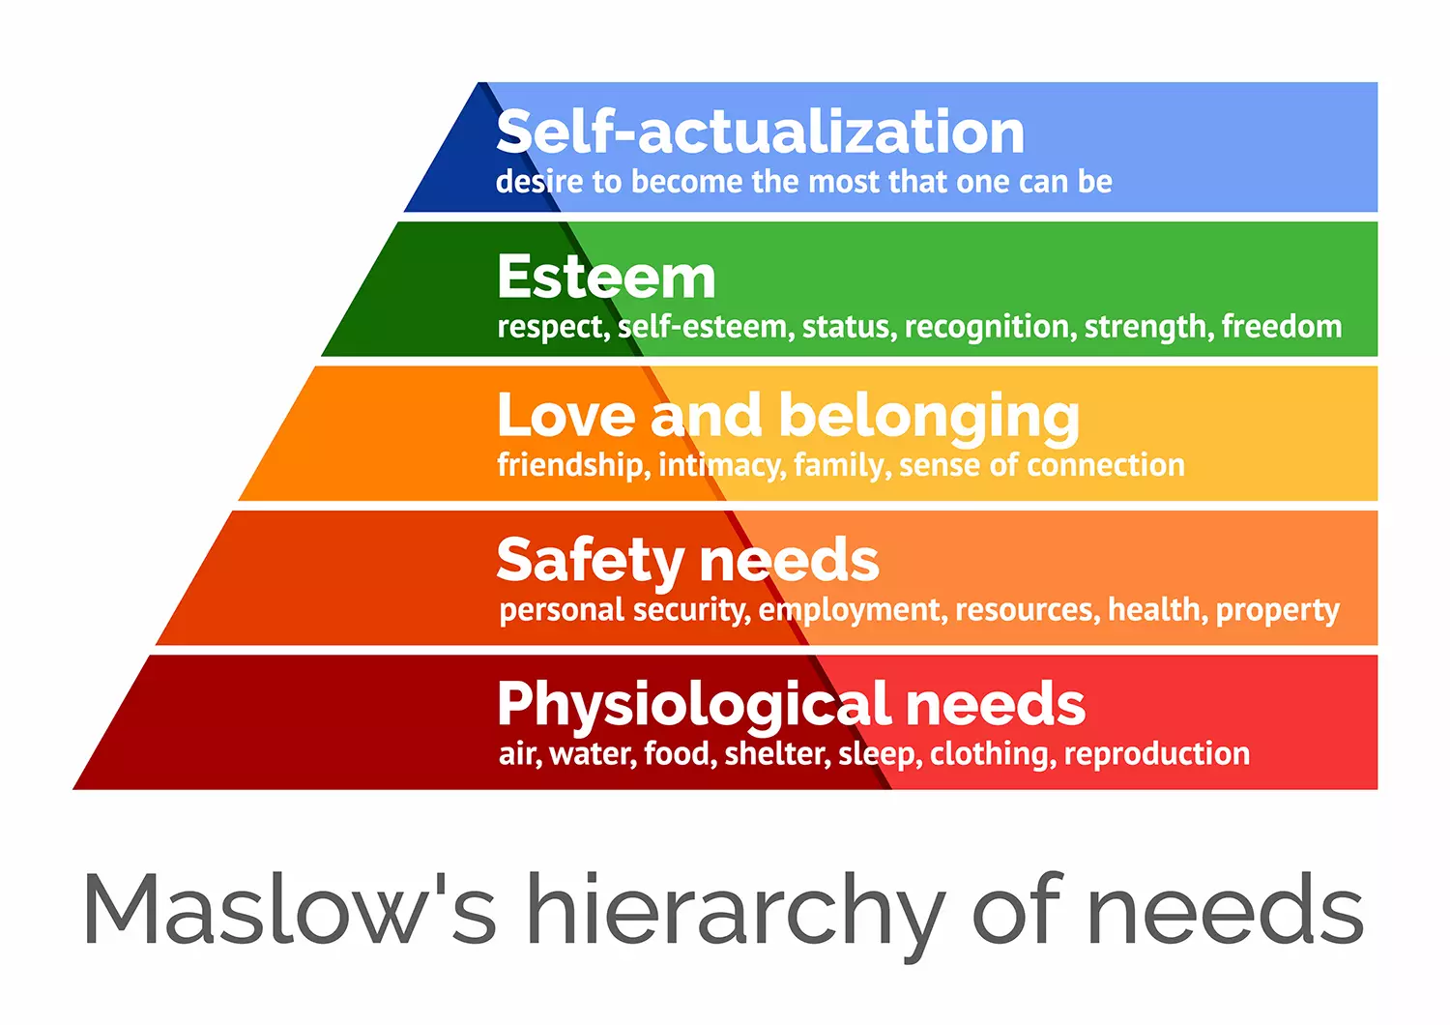
Maslow’s Hierarchy of Need
Motivation increases as needs are met and motivation decreases as needs are met…
  Self Actualization
  Esteem
  Love/Belonging
  Safety
  Physiological

Slide 15
Psychological Safety
  In Teams
  Can I take risks?
  Will I be shamed?
  Will I be accepted?
  Will I be respected?
  Have I done enough, right?
Psychological safety is the belief that one will not be punished or humiliated for speaking up with ideas, questions, concerns, or mistakes.

Slide 16
Life Stages
  Stages of Life
  Infancy
  Toddlerhood
  Should I stay still?
  Preschool
  Early School
  Young Adulthood
  Middle Adulthood
  Late Adulthood
There are 8!
Notes:
According to betterup.com

Slide 17
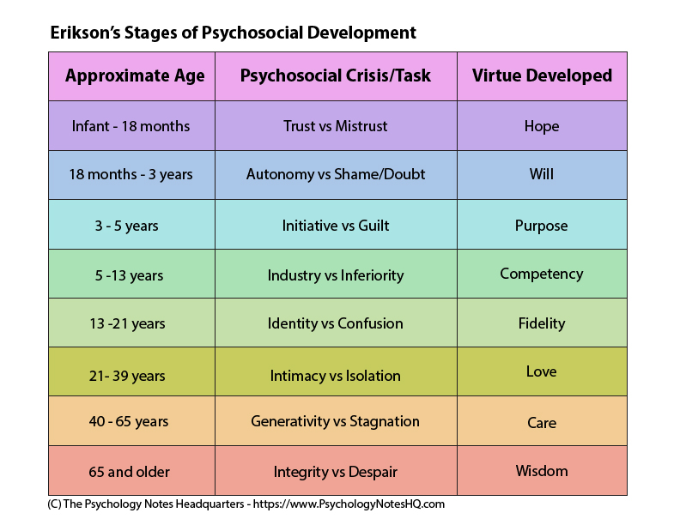
Stages of Psychosocial Development
Erik Erickson
Notes:
According to PsychologyNotesHQ.com

Slide 18
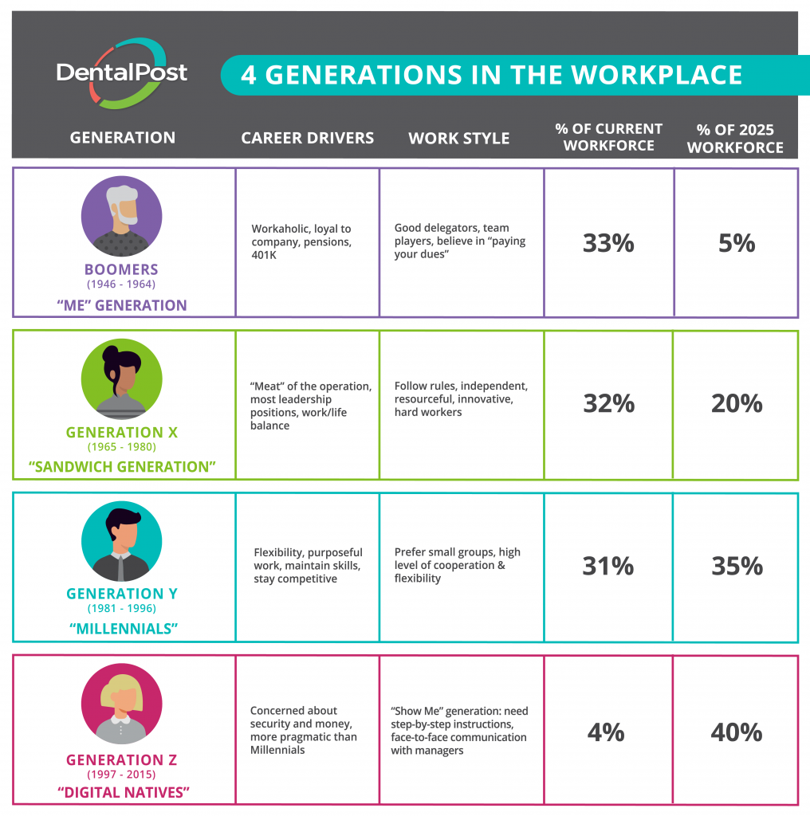
Generational Mindsets
When were you born...
Notes:
According to DentalPost!

Slide 19
  Internal
  Efficacy
  Beliefs
  Financial
  Physical
  Biological
  Emotional Maturity
Factors
There is only so much you can learn in a single place and time.

Slide 20
Factors
  External
  Community
  Life Experiences
  Geographic Location
  Environment
  Accidents and Incidents
  Quality of the Physical Environments
The factors lying outside the individual's environment are said to be the external factors affecting growth and development.
Notes:
According to Educerecentre.com

Slide 21

Things to Consider
  Ready
  Fit
  Prepared
  Goals
  Needs
  Share Your Plan
  Vision
  Acceptance
Notes:
Are you ready for the new year and new you?

Slide 22
Things to Consider
The Person
Best Practices:
Many factors are contributing to where the person is at any point in time within there employment.
It’s to outline the needs of the business and the job.
Consider available resources, tools training, and mentoring opportunities for the individual to be successful.

Slide 23

Career and Personal Demands

Slide 24


Different Responsibilities Require Different Skill Sets

Slide 25



Factors That Influence Decisions
WORK DEMANDS
COMMUNITY
Responsibility
Responsibility

Slide 26

Factors That Influence Decisions
Education
Certifications
Responsibility
Responsibility

Slide 27

Factors That Influence Decisions
Family
Self
Responsibility
Responsibility

Slide 28

Dream BIG First.

Slide 29
Things to Consider
Career and Personal Demands
Best Practices:
Responsibilities look different in every aspect but exist, nonetheless.
Communication, transparency and listening are tools that help people understand.
Courageous Conversation are also crucial.

Slide 30

Ways to Engage

Slide 31
Ways to Engage
01.
02.
03.
04.
Purpose
Vision
Values
Communication

Slide 32
Ways to Engage
Why are we here?
What is the work?
Why are we doing the work?
Who is the customer?
Why the product?
01.
02.
03.
04.
Purpose

Slide 33
Ways to Engage
Where are we going?
When?
Why?
How did we decide that?
01.
02.
03.
04.
Vision

Slide 34
Ways to Engage
Personal Alignment
Business Alignment
Customer Alignment
01.
02.
03.
04.
Values

Slide 35
Ways to Engage
Ask Five Whys
Repeat
Show
Roadmap
01.
02.
03.
04.
Communication

Slide 36

Listen
  Listen Sessions
  Surveys
  Quarterly Check-ins

Slide 37

Remove Roadblocks
  People Want to Feel Successful
  People Need Tools
  Resources
  Help

Slide 38

Create Opportunity
  Inclusion
  Ideas
  Positive Disruption
  Process Improvement
  Stretch
  Development and Training

Slide 39
Things to Consider
Ways to Engage
Best Practices:
The best way to engage is to ask. Ask what matters to the individual.
Share your story.
Share your vision.
Share what you are responsible for in the workplace.

Slide 40


You Matter

Slide 41

QUESTIONS?

Slide 42
Thank you
for your time.

