Slide 1
Cybersecurity, Protection, and You in 2023
January 5, 2023

Slide 2

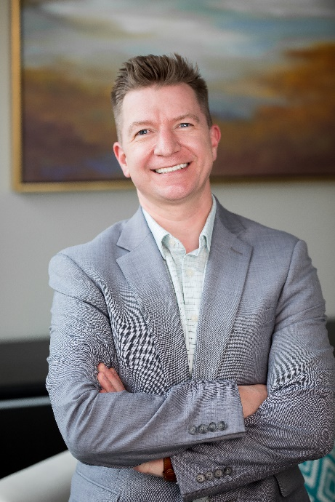
Presenter
Andy Lindley – Chief Information Officer
Andrew (Andy) grew up in a small town in the mountains of Montana. In his early career, Andy worked in an underground Platinum and Palladium mine before entering the world of technology. In the early 2000s, Andy worked with Microsoft, Nike, and Intel as a technical instructor and consultant in Active Directory and Windows XP. Andy was the owner of a managed service provider in Billings, Montana, before joining the organization Vensure Employer Services would eventually acquire in April 2020. Since then, Andy has served as the Chief Information Officer for Vensure, working with Alex and the Executive Team as Vensure continues to expand globally. During the early morning hours, Andy enjoys CrossFit and trail running.

Slide 3

Cybersecurity at a Glance
2 in 3
Small and mid-sized organizations go out of business within 6 months of a cyber attack
32% of victims
Paid a ransom demand in 2021
450+
New CISA exploited vulnerabilities in 2022
4,000
Ransomware Attacks occur on average every day
$1.7M
Lost per minute to cybercrime
95%
Of breaches are caused by human error

Slide 4





Staying Safe
PATCH EVERYTHING,
QUICKLY
TEST YOUR BACKUPS
TRAIN YOUR EMPLOYEES
Contingency Plan
Vensure is now SOC 2 Type 1 Certified!
Implement a robust and strict security awareness training program.
Cyber Insurance, Cyber Protection Packages, and Personal Identity Protection provide peace of mind.
Ensure your patching policy is aggressive and up to date. Critical patches should be installed weekly.

Slide 5





Staying Safe
STRONG PASSWORDS
ENDPOINT PROTECTION
MFA!
Bare minimum of 8 characters, but ideally 12 or more.
Review your endpoint protection and update if needed. If possible, utilize a third-party provider for monitoring.
Ensure that you have MFA enabled for every application that you can.

Slide 6

QUESTIONS?
Andrew.Lindley@vensure.com

Slide 7


Today’s
Sponsors

Slide 8
Thank you
for your time.
PartnerGrowth@vensure.com
https://www.vensure.com/ https://www.vensure.com/resources/webinars/

