Slide 1

Thinking Bigger:
Embracing a Multicultural Mindset

Slide 2

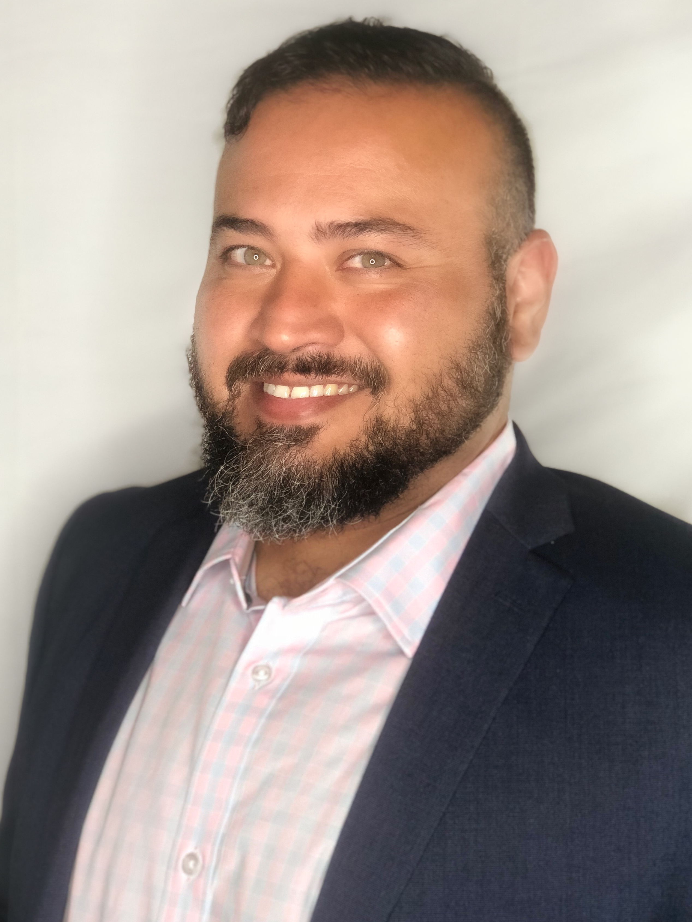
Abraham Gonzales-Pollick
Host
is on a mission to share HR and organizational development knowledge to help business owners across the globe. He has more than 20 years of client service and product management leadership experience, 15 of which have been spent in the PEO space. Abraham sits on the board of various non-profit organizations and has a strong entrepreneurial spirit. He is a highly-regarded keynote speaker and global facilitator on several HR topics, including “Evolving the HR Mindset.”

Slide 3

WHAT IF…
You were asked to sit on a team where team members were from a different time and place, would you have what you need to thrive?

Slide 4

WHAT IF…
You were transplanted in another part of the world to do a job,
do you have what you need to be successful?

Slide 5

WHAT IF…
You are leading a multicultural team, do you have all skills
you need to drive engagement and performance?

Slide 6

What makes you who you are?
Notes:
And more question for you to take a moment and consider, is: What makes you who you are? Think about your values, roles, social status, age, beliefs and more.

Slide 7



Today’s Topic and Learning Outcomes
We are going to examine cultural concepts which will enable you to be more effective and set you up for success wherever you are brave enough to embark on a working adventure or leading a team! We will also explore global mindsets and how to thrive in or lead a multicultural team.
How to use global mindset concepts in local leadership.
How to build trust, confidence and cultural awareness
Tools for shaping team culture
Notes:
Thank you for entertaining some of my questions! Today we are going to dig a little deeper in our personal skills and for some of us, our leadership capabilities and try on some key learning.
Today’s Topic…

Slide 8

Today’s Agenda
01. Definitions and Concepts
02. Global Mindsets
03. Building Trust
04. Shaping Team Culture
© 2022 Vensure Employer Services

Slide 9
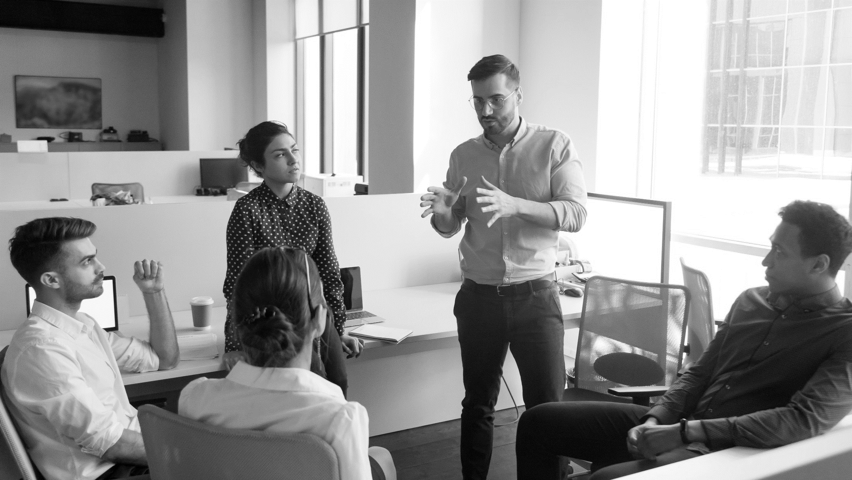
Definitions and Concepts
Notes:
Before we dive into Global Mindset concepts, let’s first and briefly examine culture to help set our foundation.

Slide 10


Culture
Shared values, ideals, beliefs, and behaviors.
There are elements that are seen and unseen.
Notes:
A high-level look at culture.
There Elements that are seen and unseen: outward appearances that are seen and then the unseen- the thoughts and ideals people have, for example.

Slide 11

Culture
Seen and Unseen
Notes:
A high-level look at culture.
There Elements that are seen and unseen: outward appearances that are seen and then the unseen- the thoughts and ideals people have, for example.

Slide 12

Cultural Influence
  Clothing You Wear
  Beliefs
  Education
  Upbringing
  Contributions
Notes:
It is important talk about cultural influence, and especially now that our technology allows us to be more interconnected. We get to see in real time, what culture looks like and see behaviors. And in many cases inspired by such.

Slide 13


Multicultural
Of, relating to, or including several cultures.
Something that incorporates ideas, beliefs or people from many different countries and cultural backgrounds.
Notes:
Yourdictionary.com defines multicultural as such.
Very important to note here that in business we continue to see more teams and groups that have multiculturalism. As people travel the world and seek opportunities in new places we experience this movement in the moment and adjusting and learning how to interact with the complexities of people.

Slide 14

Cultural Awareness
  Understanding the influences and impacts of culture
  Knowing how our own culture shapes us individually- self awareness
  Realizing that not everyone in the world thinks like we do, and respecting those differences
Notes:
Commisceo-global.com. And here we have Cultural Awareness. A profound concept to consider as you sit on team or lead a team.

Slide 15
Cultural Identification
01.
02.
NATIONAL
ORIGIN
03.
RELIGION
GENDER
04.
05.
06.
SEX
AGE
COLOR
Notes:
Sometimes obvious elements identify an individual, such as;

Slide 16


Ethnocentrism
Evaluation of other cultures according to preconceptions originating in the standards and customs of one's own culture.
The attitude that one's own group, ethnicity, or nationality is superior to others.
Notes:
And then there is the concept of ethnocentrism.

Slide 17
B
I
A
S
“A personal and sometimes unreasoned judgement”
Source: Merriam –Webster
“Bias is an opinion or judgment regarding a person, an ideology, or a group based on personal preferences rather than the facts. Bias is also known as implicit bias, as it’s basically unconscious. People develop bias as they grow in a social setup, even without knowing it.”
Source: The Edvocate

Slide 18
STEROTYPE
“A widely held but fixed and oversimplified image or idea of a particular type of person or thing.”
Source: Oxford

Slide 19
GROUP THINK
“A phenomenon that occurs when a group of well-intentioned people makes irrational or non-optimal decisions spurred by the urge to conform or the belief that dissent is impossible.”
Source: Psychology Today

Slide 20

Weaving It All Together
Understanding these broad concepts around differences in people and how we may perceive them, help us identify what skills we may need work on to be effective in a diverse team or to lead a multicultural team.
Simply help us think bigger!

Slide 21

Considering Global Mindset
Notes:
Global Mindset is very deep and broad subject. We are going to spend a little time examining and pulling out key concepts from this subject as we put ideas inspiration into our toolbox to think bigger. Our reference for this section is drawn from GlobalMindset.com

Slide 22


In a new setting or situation: Do we tend to lean on our traditional norms, or behaviors we are most comfortable in?
Notes:
Could it be that we are so strong in our values that we may find it hard to adjust?

Slide 23

“A global mindset is the ability to recognize and reflexively adjust to cultural signals so that an individual's effectiveness is not compromised when dealing with people from different backgrounds.”
Source: RW3
Notes:
A global mindset is the ability to recognize and reflexively adjust to cultural signals so that an individual's effectiveness is not compromised when dealing with people from different backgrounds, according to CultureWizard's Global Mindset Index Study created by RW3, a firm that provides culturally-based training solutions.

Slide 24


“Global Mindset is the set of individual qualities, communication skills, and actionable knowledge that empowers those in leadership roles to influence multicultural individuals, groups, and organizations.”
Source: Thunderbird School of
Business Management

Slide 25

Global Mindset
  Skills Include:
  Curiosity
  Openness
  Self-Awareness
  Do you have these skills?
Notes:
Developing a Global Mindset | Thunderbird (asu.edu)
Have a look at these few skills and ask yourself if you feel 100% confident this is you.

Slide 26
Global Mindset
There are 3 primary dimensions of Global Mindset:
01.
02.
03.
Intellectual Capital
Psychological Capital
Social Capital
What you know.
Individual interest in engaging and leveraging what you know.
Individual behavioral propensities or disposition to interact with and build trust with people.

Slide 27
Intellectual Capital
  Global Business Savvy
  Cosmopolitan Outlook
  Cognitive Complexity
01.
Notes:
Intellectual Capital – The cognitive aspect refers to what the manager knows about global business in their industry and its broader macro environment. It also refers to how easy it is for them to analyze, digest and interpret this information.

Slide 28

Intellectual Capital
Global Business Savvy
  Knowledge of global industry
  Global competitive business, and market strategies
  Knowledge of how to transact business and assess risks of doing business internationally
Notes:
Business saavy in an international setting may seem like its not relevant if you are managing a business here locally in the US. However, people from diverse backgrounds learned who may be on your team, learned different concepts about business respectively to their culture or country. Having knowledge of business saavy broadens your credibility and power of influence.

Slide 29

Intellectual Capital
Cosmopolitan Outlook
  Knowledge of cultures in different parts of world
  Knowledge of geography, history, and important persons of several countries
  Knowledge of important world events
Notes:
Intellectual Capital – The cognitive aspect refers to what the manager knows about global business in their industry and its broader macro environment. It also refers to how easy it is for them to analyze, digest and interpret this information.

Slide 30

Intellectual Capital
Cognitive Complexity
  Ability to grasp complex concepts quickly
  Ability to understand abstract ideas
  Ability to take complex issues and explain the main points simply and understandably

Slide 31
Psychological Capital
  Passion for Diversity
  Quest for Adventure
  Self-Assurance
02.
Notes:
Psychological Capital – The affective aspect refers to the manager’s emotional energy, capacity for self-reflection, and willingness to engage in a global environment. It reflects a positive and constructive attitude towards diversity of thought and action. It is the desire and ability to understand and embrace cultural differences.

Slide 32

Psychological Capital
Passion for Diversity
  Enjoyment of exploring other parts of the world
  Enjoyment of getting to know people from other parts of the world
  Enjoyment of travel

Slide 33

Psychological Capital
Quest for Adventure
  Interest in dealing with challenging situations
  Willingness to take risks
  Willingness to test one’s abilities

Slide 34

Psychological Capital
Self-Assurance
  Energetic
  Self-Confident
  Comfortable in uncomfortable situations

Slide 35
Social Capital
  Intercultural Empathy
  Interpersonal Impact
  Diplomacy
03.
Notes:
Social Capital – The behavioral aspect reflects the individual or leader’s ability to act in a way that helps build trusting relationships with people from other parts of the world. Whether you're heading for a leadership role in the private or public sector, understanding how social capital works in global companies, governments, and nonprofits is essential for anyone working in an organization.

Slide 36
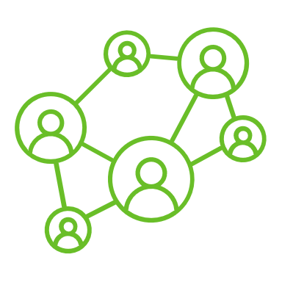
Social Capital
Intercultural Empathy
  Ability to work well with people from other parts of the world
  Ability to emotionally connect to people from other cultures
  Ability to understand non-verbal expressions and ability to engage people from other parts of the world

Slide 37

Social Capital
Interpersonal Impact
  Experience in negotiating contracts/agreements in other cultures
  Strong network with people from other cultures and with influential people
  Reputation as a leader

Slide 38

Social Capital
Diplomacy
  Ease of starting a conversation with a stranger
  Ability to integrate diverse perspectives
  Ability to listen to what others have to say
  Willingness to collaborate

Slide 39

Weaving It All Together
  People are complex
  Business objectives have purpose and high stakes
  Interpersonal skills vary
  Teams and organizational culture is driven by the experience and interaction created by people
  Competitive advantage plays a role in talent and customers

Slide 40

“By adopting a global mindset, organizations can overcome the sometimes-hidden biases that hinder engagement and limit growth potential in this hyper-competitive talent market.”
Source: Forbes
Notes:
And remember as we examined in the previous slide’s, global mindsets are a set of tools that individuals can embrace to navigate more effectively in diverse team settings.

Slide 41
“Leaders with a strong Global Mindset are more successful at putting together global teams who work effectively together.”
Source: Mansour Javidan, Ph.D., Jennie L. Walker, Ph.D.
Notes:
In our next segment we will dive a little deeper on the concept of building trust, confidence, inclusion and create psychological safety within diverse teams…shaping team culture.
We will go through a handful of ideas for you to consider.

Slide 42

Building Trust with a Global Mindset
Notes:
And here we are that last portion of our webinar. Ideas for building! As it is important to drive the business forward having strong team dynamics and embracing diversity could serve as essential. Let’s dive in.

Slide 43

Idea 1
Be Curious
Make Efforts
Study Cultural Norms
Notes:
As simple as it may seem, being curious certainly takes effort and mindfulness.
And being curious also take pre-work and studying cultural norms.

Slide 44


One of the ways of building trust starts with curiosity
Cultural Curiosity: The purpose of cultural curiosity is to develop an appreciation for different cultures and people from those cultures. Having an understanding of someone's culture can help you better empathize with them, which might create a more comfortable working relationship.
Soure: Indeed
Notes:
Indeed suggest that Cultural Curiosity

Slide 45

Idea 2
Create Space For:
Storytelling
Dialogue
Presentation
Guest Speakers
Diverse Interest Groups
Notes:
It is so easy for people to get in the rhythm of day to day business that we almost go into auto-pilot and forget that people are among us and there is potentially some rich interaction that could happen to inspire the week.

Slide 46

Idea 3
Corporate Culture
Values and Mission Statement
Ethics Statements
Notes:
Every organization could use a road map when living their purpose. As we are encouraging people to think bigger and embrace the talent that is driving this purpose, some great staples in an organization are the statements around corporate culture, values, mission and ethics.

Slide 47

Idea 4
Connect
Contribute
Coach
Mentor
Notes:
Another idea for building trust, confidence, inclusion and creating psychological safety is to create opportunity for people connect, contribute, coach and mentor one another.
Learn from one another and hopefully be inspired to think broader about their contributions and impact thereof.

Slide 48

Idea 3
Integrate Diverse Perspectives and Ways of Interacting:
Communication
Activities
Create Situations to Listen to Others
Mindfulness- Active Listening
Find things in common that are varied interests, kids, sports, food, music.
Notes:
And in our 5th idea of how to build Trust and inclusion within multicultural teams is to integrate diverse perspectives and ways of interacting…. I would like to share a couple of stories before we examine what is on this page.
You know I stand back and I reflect on the last 5 ideas we have shared and I have to admit there was a time in my career journey that I had not thought about how important it was to interact differently with teams- I was stuck in doing things my way or stuck in my own enthnocentrisms , until I started listening to other ideas… and realizing the positive outcomes after trying those ideas.
And I am both surprised and not surprised at the amount of time it took for me to realize that my way of doing things was not the only way. I was a product of my culture, experience and learning at that time. As I learned more my interactions with people evolved and got better and then something wonderful happened, I started mentoring other people on how to expand their skills around culture and engagement.
And so,
A brief story on how these ideas found their way on the screen:
I was conducting an engagement strategy session with a group a senior leaders and one of the leaders who in normal business and day to day interaction was very direct and appeared to be cold. I mean you did not get any warm vibes, ever from him. Some had commented that he himself was disengaged. So imagine the concern that a leader who was responsible for engaging leading a team was he himself potentially disengaged. When he got the opportunity to share his ideas, he left the people in the room stunned and inspired. He very warmly said we need to have a family picnic where our employees can bring their families and socialize.
It is important that we understand our people and what matters to them, who is important to them and see them in their natural life outside of work- see their culture, so that they feel seen and important while they are at work. He further stated, we are a global organization and we have stopped celebrating people…
WOW- and this this whole time we thought he was cold and indifferent.
Let’s unpack this now, the ideas on this page really speak to creating opportunity for people to be seen as who they are and where they come from.

Slide 49

Shaping Team Culture
Notes:
And so no that we have examined key culture concepts, global mindset attributes, ideas for building trust and more, it’s now the time to look deeper and lastly at what is Shaping Team culture and what could further inspire Thinking Bigger.

Slide 50


Difference in Cultures
Understanding not just how culture is different, but why is more relevant.
WHY
HOW
Notes:
Understanding not just how culture is different, but why is more relevant when thinking about shaping culture, because it will help influence how people feel comfortable in team settings.
It will influence how to maximized team contributions,
and understanding why will help foster meaningful outcomes and potentially hitting business objectives.

Slide 51



Culture Informs Values and Influences Practice
Influence
Practices
Culture
Values
Notes:
Understanding the why of someone's culture provides a lens into what is informing someone values and influencing their practice. In other words it tells a story as to why people approach to work is what it is and how they perceive their value and contributions or their personal efficacy and/ or psyche.

Slide 52




Experience
Psyche
Historical
Events
Environments
Notes:
There are other outcomes within culture that impact psyche and self efficacy…

Slide 53

Elements of Strong Team Culture
  Psychological Safety
  Inclusive Ideas
  Celebrating Differences
  Common Goals
  Social Capital
Notes:
Lets examine social capital a little deeper.

Slide 54
01
02
Common
Values
Trust
Social
Capital
03
04
Support
Structures
Norms
Participation
05
06
Order
Notes:
Let’s unpack social capital a little more and discuss why it is important to shaping team culture.

Slide 55

Thinking Bigger
  Inclusion
  Sensitive
  Stronger Communication
  Engagement
  Business Alignment
  Increased Performance
  Commitment
  Important Relationships Between Teams and Leaders
Notes:
Thinking Bigger and embracing new concepts for interacting yields many positive results.

Slide 56

In Summary
  Embracing multiculturalism allows for a broader mindset
  Understanding Culture and the influence it has on the way people show up and produce outcomes is a huge step up to building trust, strong teams and impactful outcomes
  Personal Bias are important to recognize
  Global Mindset concepts help deepen your understanding the people you interact with, and or lead.

Slide 57

QUESTIONS?

Slide 58
Thank you
for your time.

